Slide 1
Introduction to Programming Applications with Python
By: Iman Khani Jazani
Senior Data Scientist, Adin
Technical AI Product Manager and Advisor, Mehra
NLP Researcher, VoXera
Adjunct Professor, Sharif University of Technology

Slide 2
Today
Course Information
Discussion about Programming and Python in Research and Industries
Why we use Python
How to use Python

Slide 3
Course Information

Slide 4
Grading
Approx. 20% Programming Assignments
Approx. 2% Challenging Questions and Contributions in Class
Approx. 13% Mid-term Project (alone)
Approx. 35% Final Project (team work~5 member)
Proposal (about real needs)
Coding
Release
Approx. 30% Final Exam
Approx. 5% Presentation with Code(extra score)

Slide 5
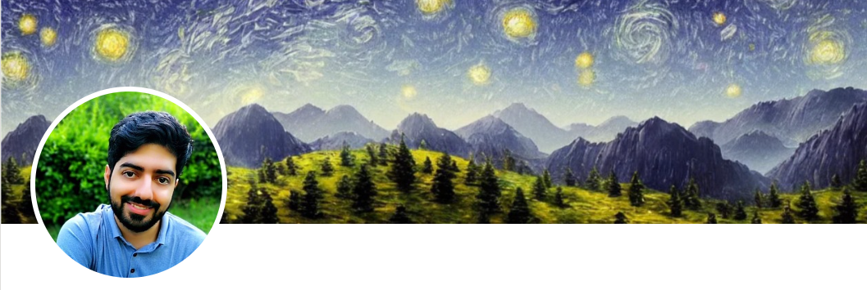
Contact me
Gmail: ImanKhaniJazani@gmail.com
LinkedIn: https://www.linkedin.com/in/ImanKhaniJazani/
Telegram: @IKJ1992

Slide 6
Main links for our class
Telegram group: t.me/SharifPythonSpace1401
GitHub organization: github.com/SharifPythonSpace

Slide 7
Together
Send your feedback about the class whenever you want!

Slide 8
Course plan
Fundamental concepts in computer science
Algorithm thinking
Coding with Python
Some meetings with Python experts in different domains (maybe)

Slide 9
Be in path
Programming Language
Knowledge of Concepts
Algorithm Thinking

Slide 10
TAs plan
Python workshop abut AI and DS
Python Coding class for assignments
Python Event for CE department (maybe)
Useful Python toolkits in industry:
Git, GitHub
Docker
FastAPI
Dask
…

Slide 11
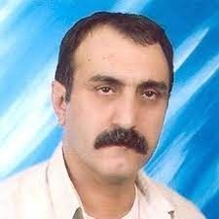
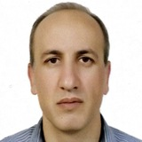
MANY Thanks to…
Dr. Abbas Nowzari
Associate Professor, Tehran University
Dr. Mohammad Ganjtabesh
Associate Professor, Tehran University

Slide 12
Discussion about Python in Research and Industries

Slide 13
What is programming?

Slide 14
What is Python?

Slide 15
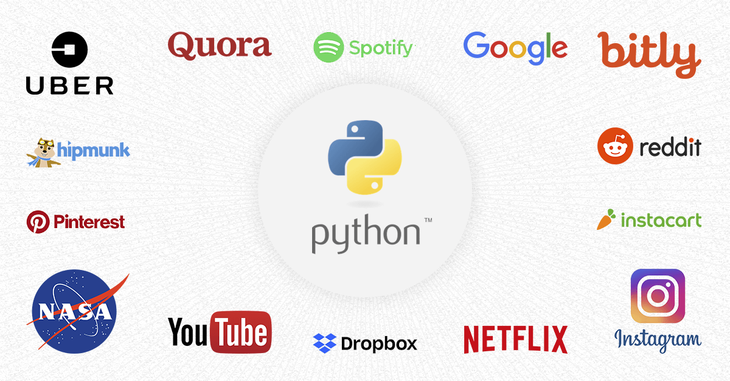
Do you know about its applications?

Slide 16
Why we use Python?

Slide 17
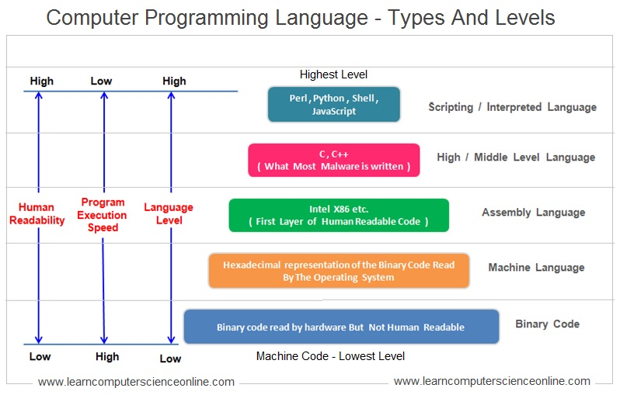
Language!

Slide 18
How to use Python?

Slide 19
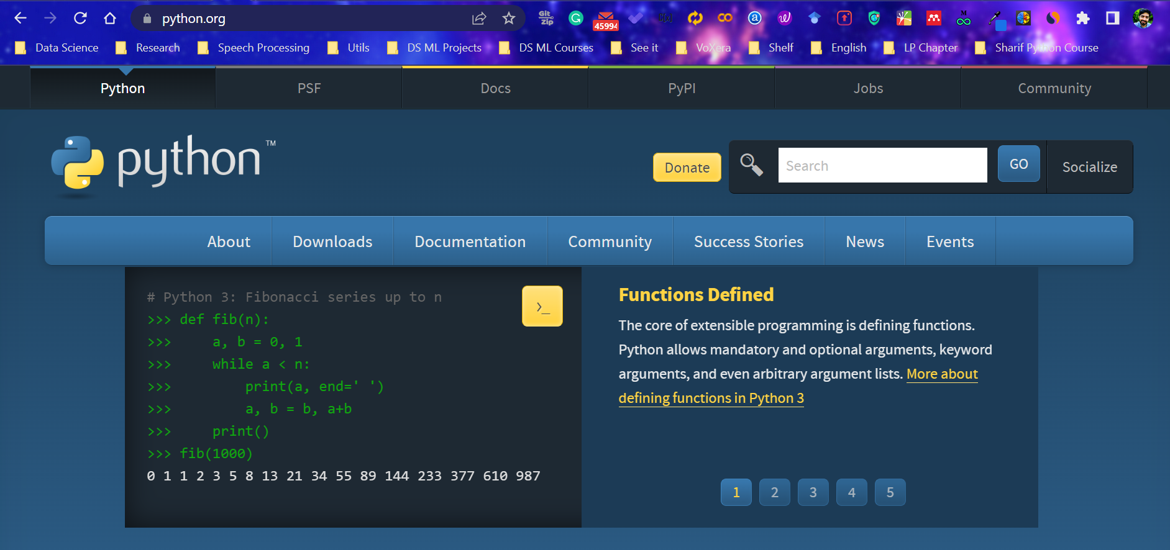
First, install Python

Slide 20
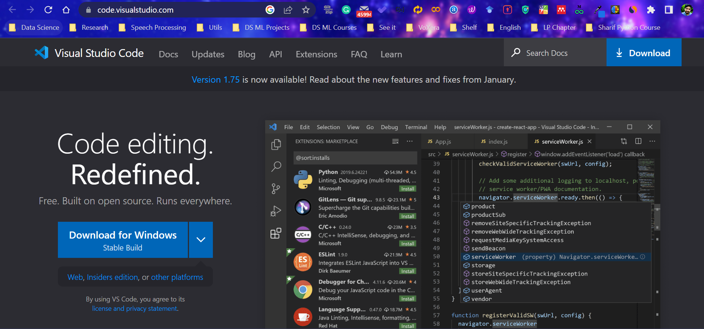
Second, install visual studio code (vscode)

Slide 21
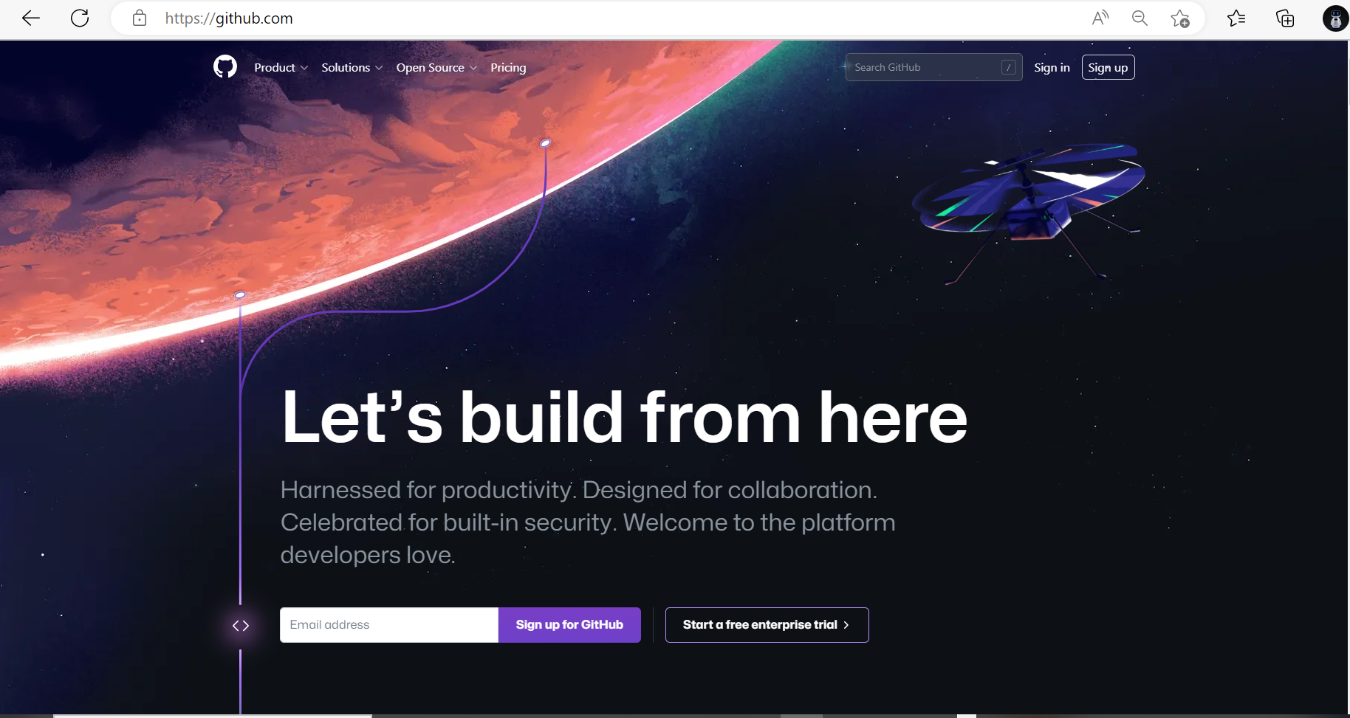
Third, register in GitHub

Slide 22
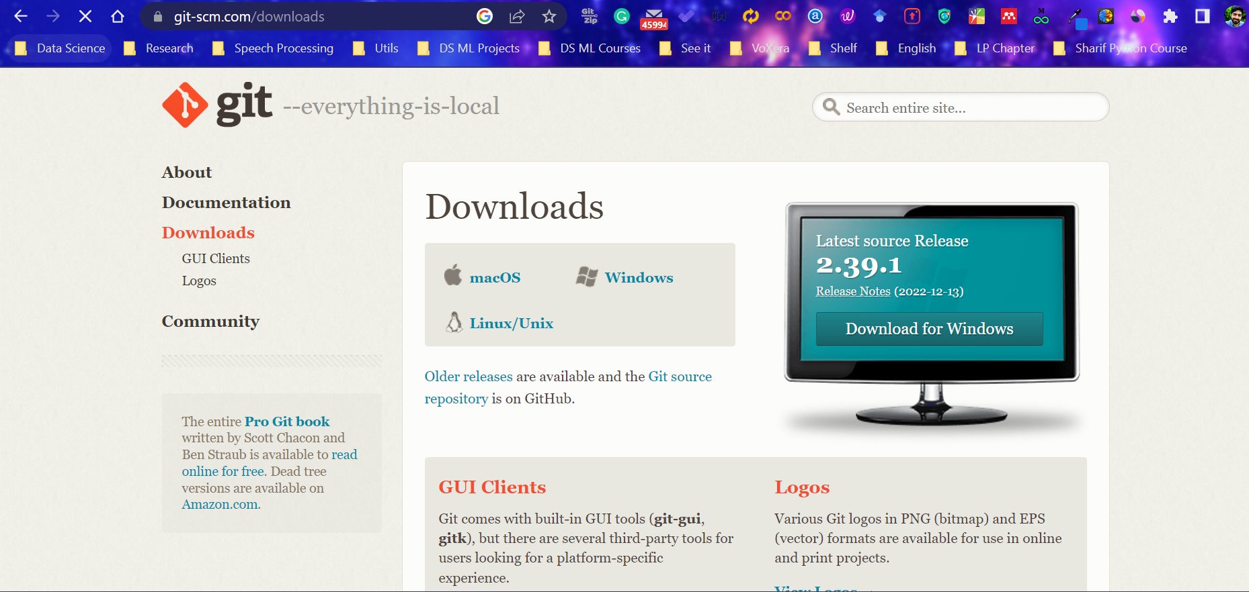
Fourth, install Git

Slide 23
Lecture Resources
P. Wentworth, J. Elkner, A. B. Downey, C. Meyers. How to Think Like a Computer Scientist: Learning with Python. 3rd Edition, Open Book Project, 2011.

